Slide 1
AfriGEO Symposium: Building Resilient and Sustainable Systems
Zviko Mudimu
Head of Operations
Notes:
Title Slide

Slide 2
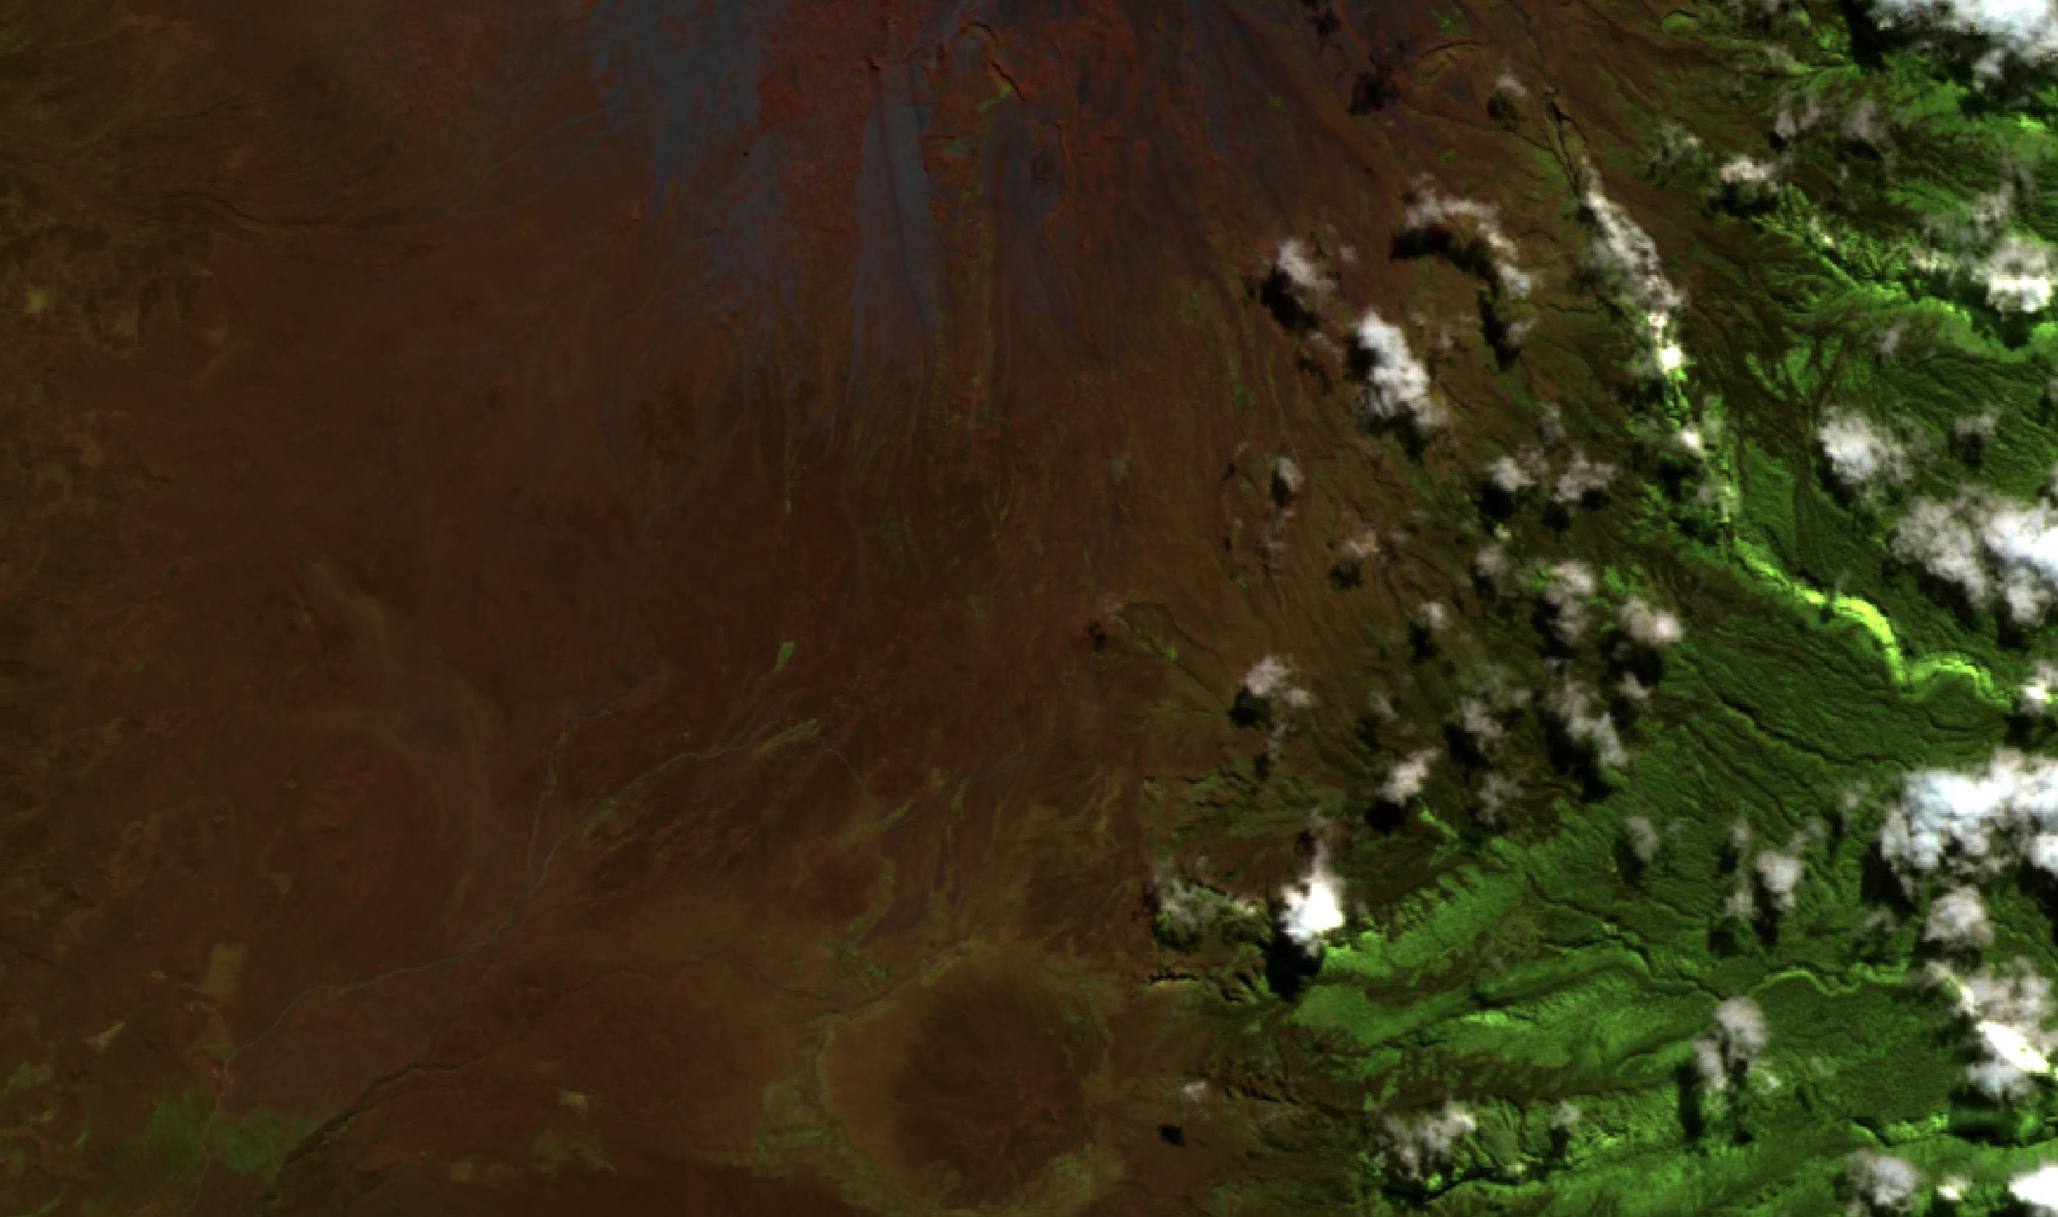
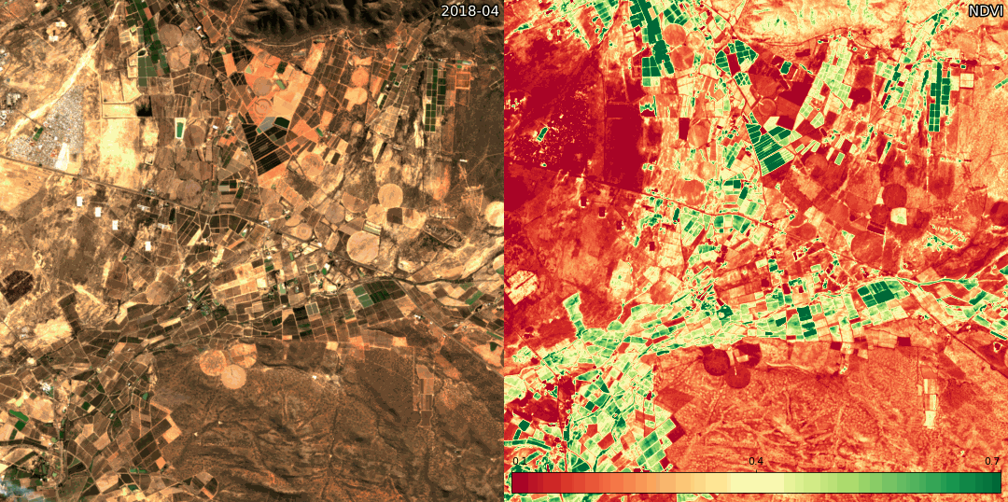
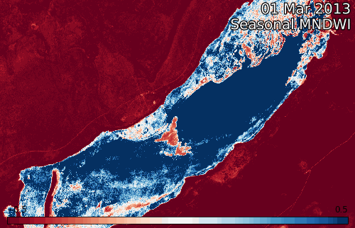
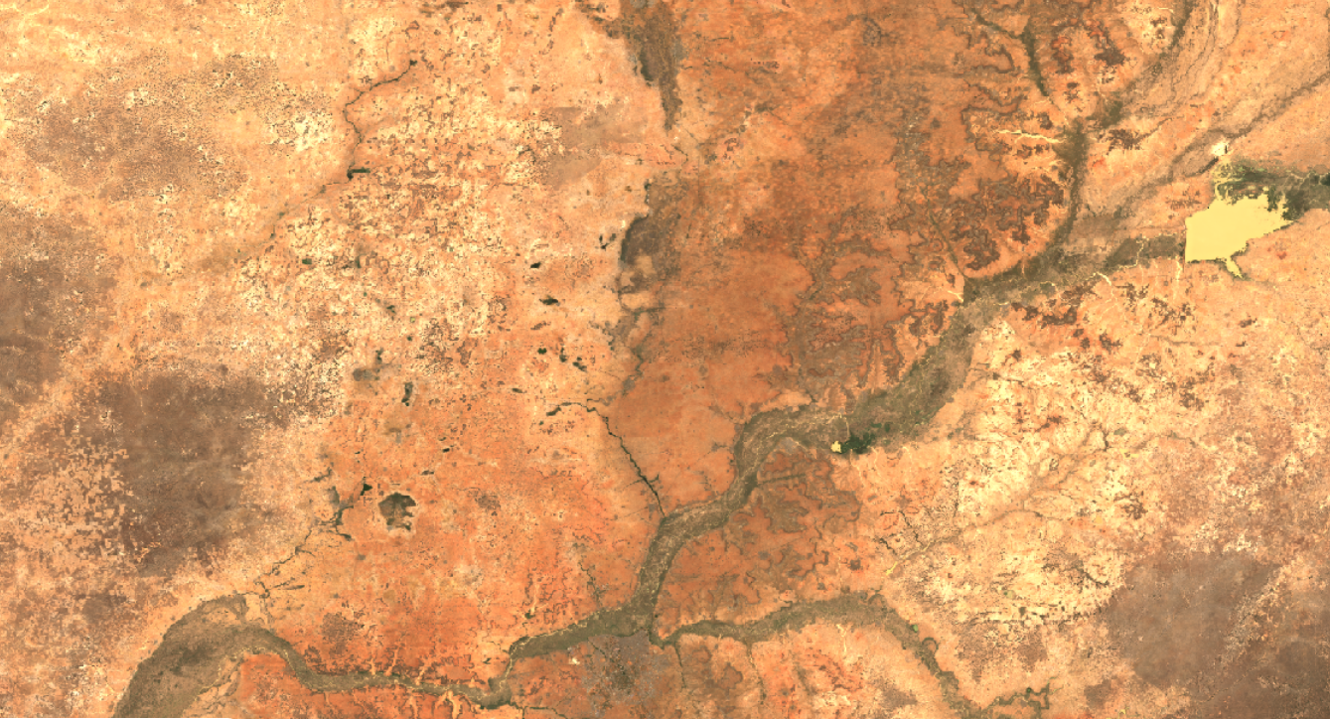
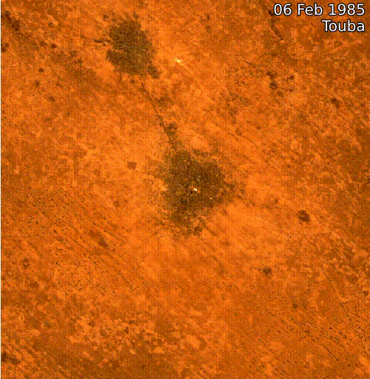
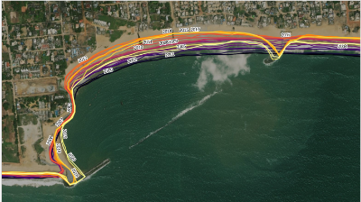
Agriculture and food security
Water resources and flood risks
Land cover change
Our Vision
Powered by partnerships, Digital Earth Africa provides a public infrastructure and accessible analytics to unlock the value of Earth observations for government decision-makers.
We are responsive to the information needs, challenges and priorities of the African continent.
DE Africa is building on existing capacity to enable the use of Earth observations to address key challenges across the continent.
Urbanisation
Coastal erosion
Notes:
Eye of Sahara: Credit: LContains modified Copernicus Sentinel data 2021, processed by Digital Earth Africa

Slide 3
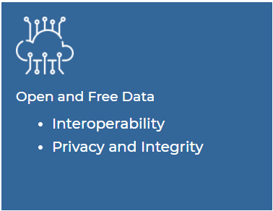
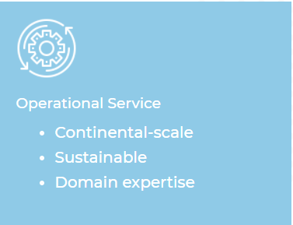
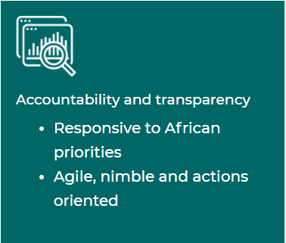
Bazaruto Archipelago: Credit: Contains modified Copernicus Sentinel data 2020, processed by Digital Earth Africa.
Notes:
We operate according to a number of key principles:
The data from DE Africa is free and open and interoperable, removing barriers to use and re-use of the data – it can be shared by anyone governments and industry alike
Operational services that cover the entire continent and which can be technically sustained, so that people anywhere in Africa have the opportunity to benefit from DE Africa services
Accountability and transparency, with governance that ensures that DE Africa delivers to African needs and meets funders’ expectations
Diversity and Inclusion, harnessing the power of diverse communities and fostering collaboration

Slide 4
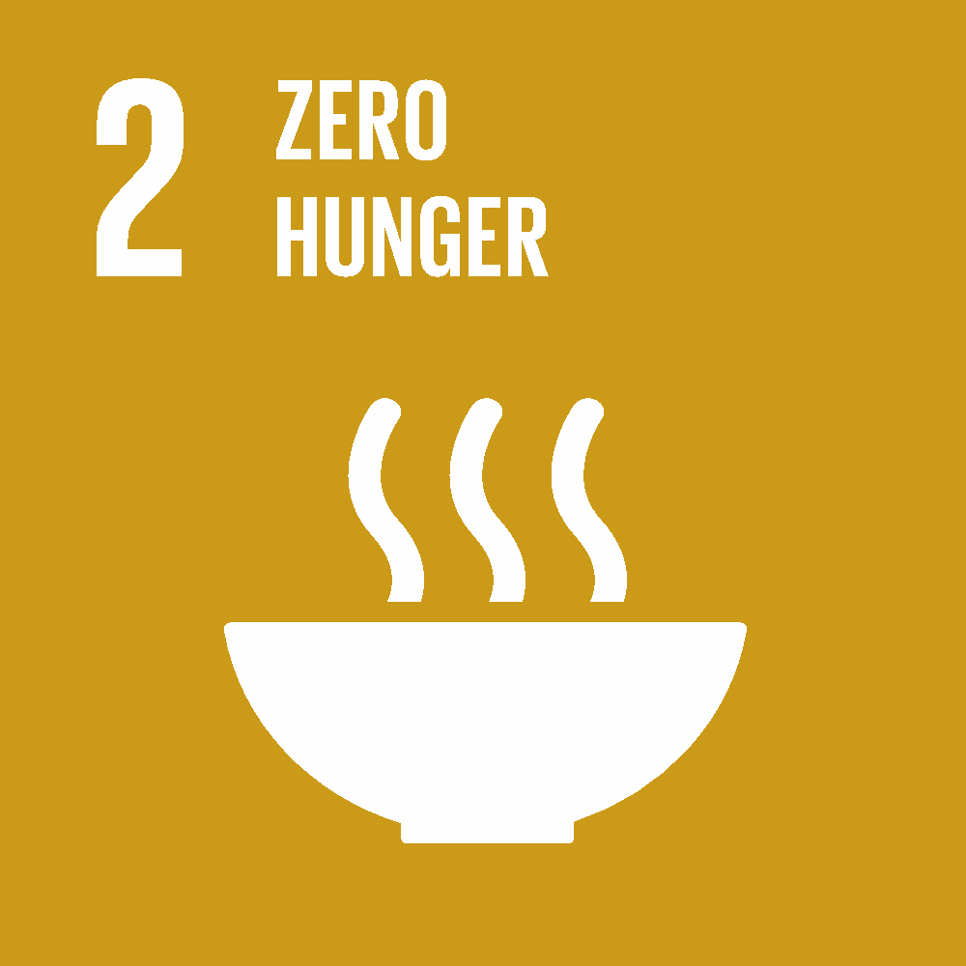
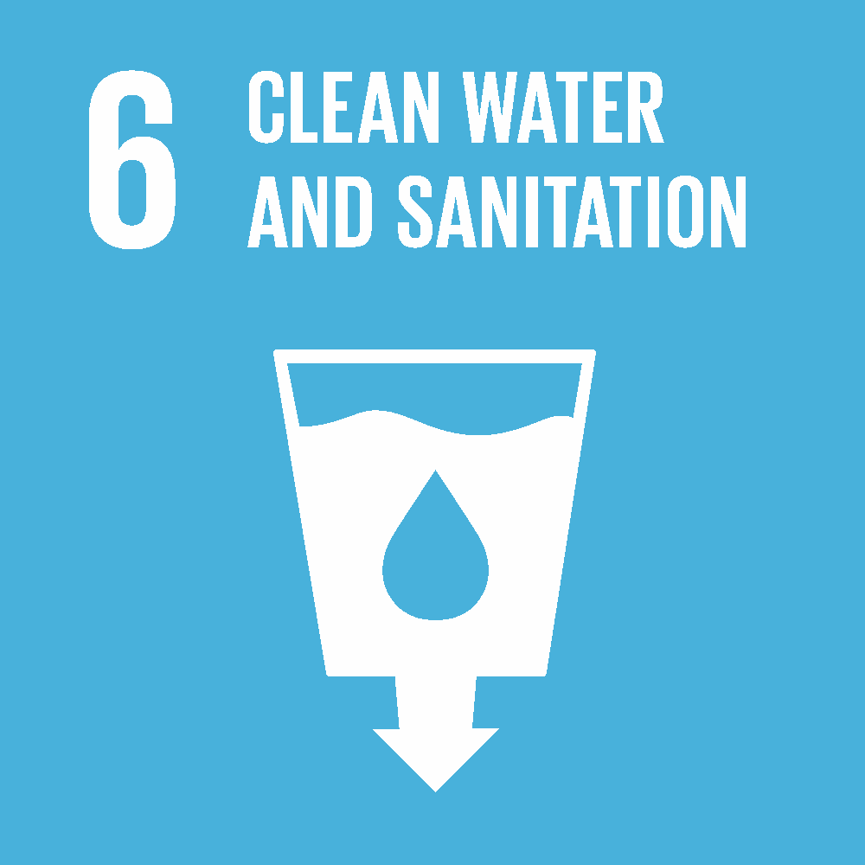
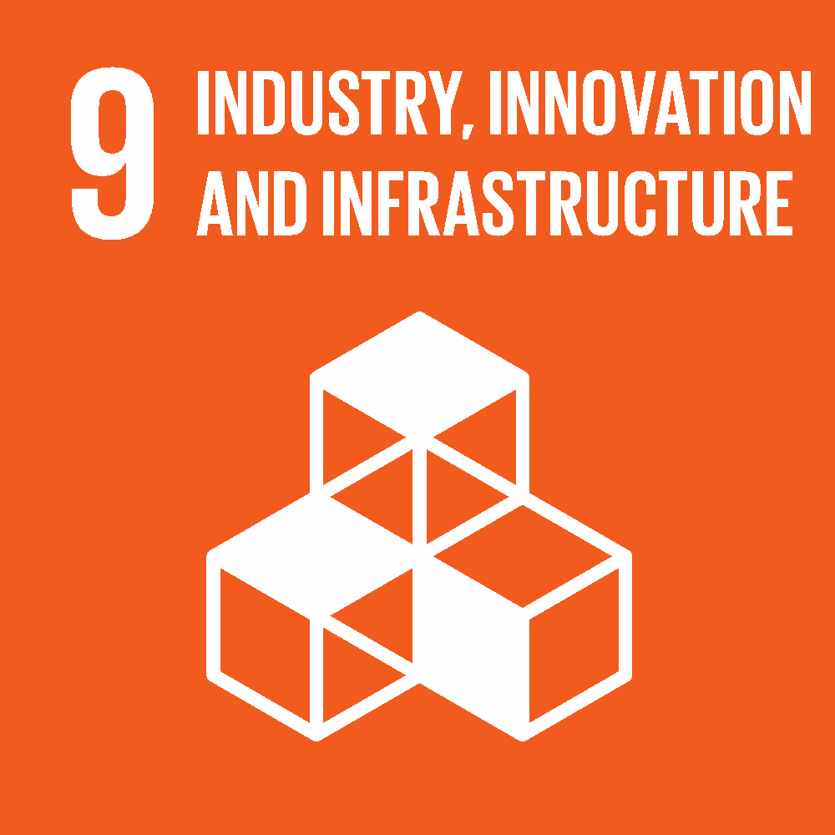
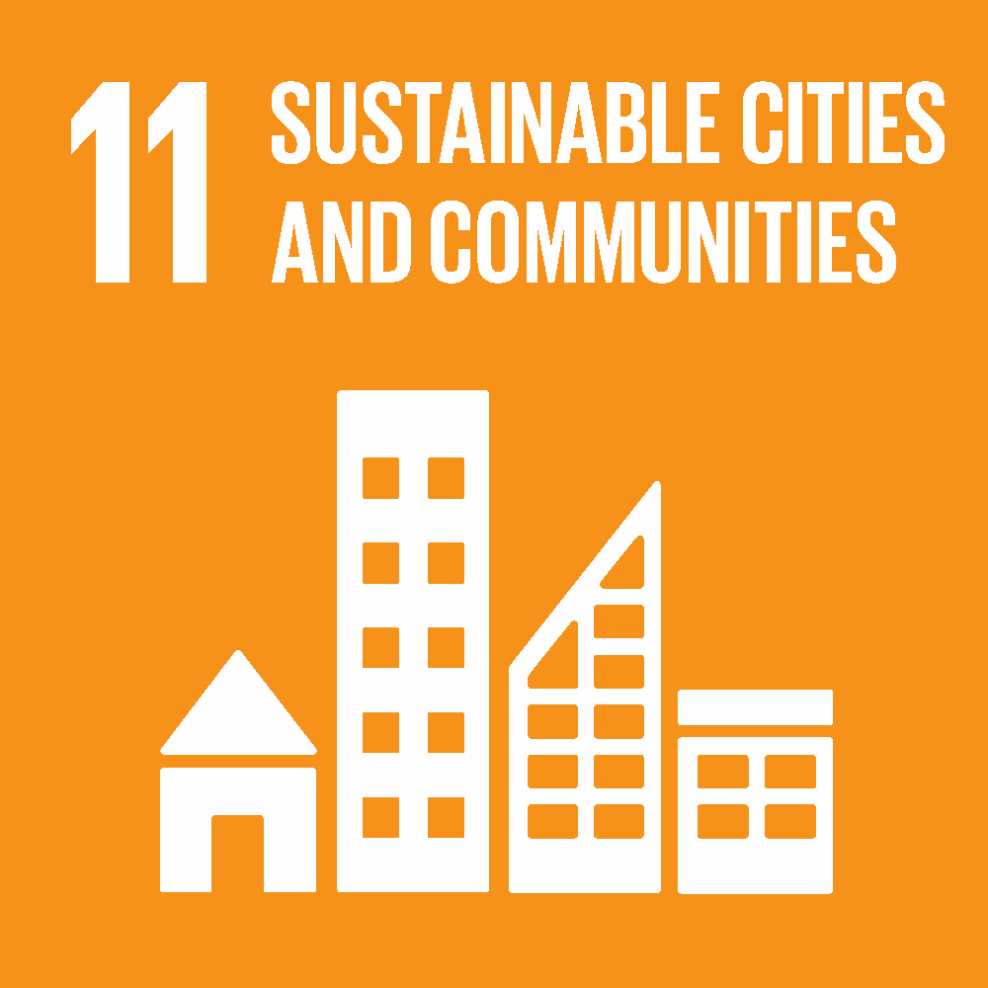
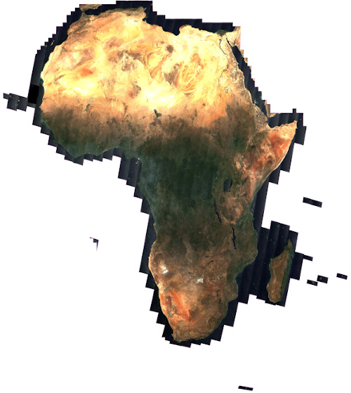
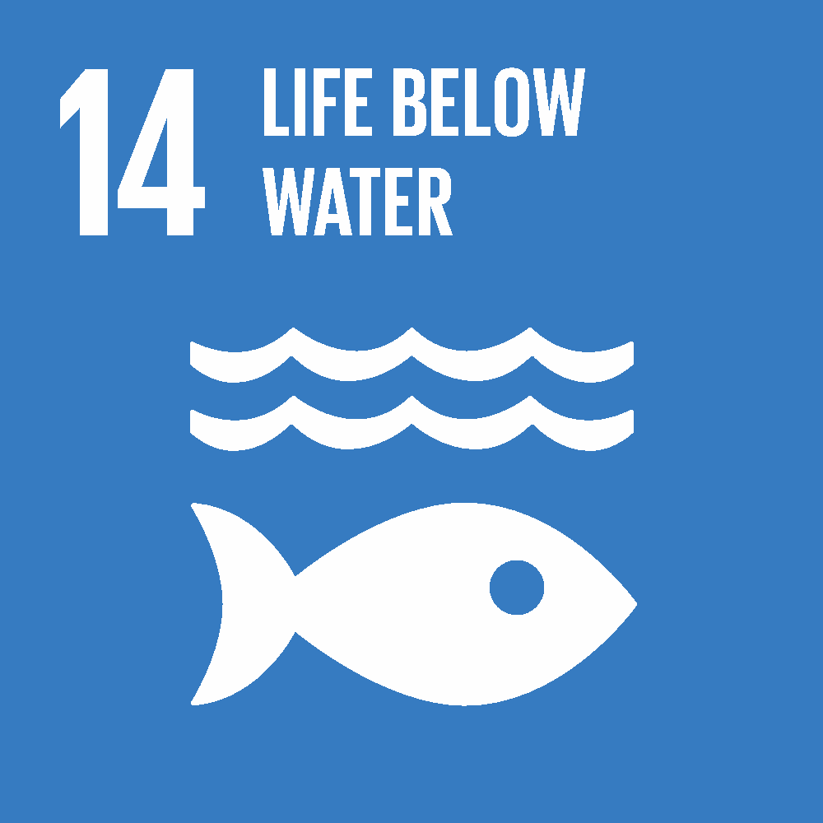
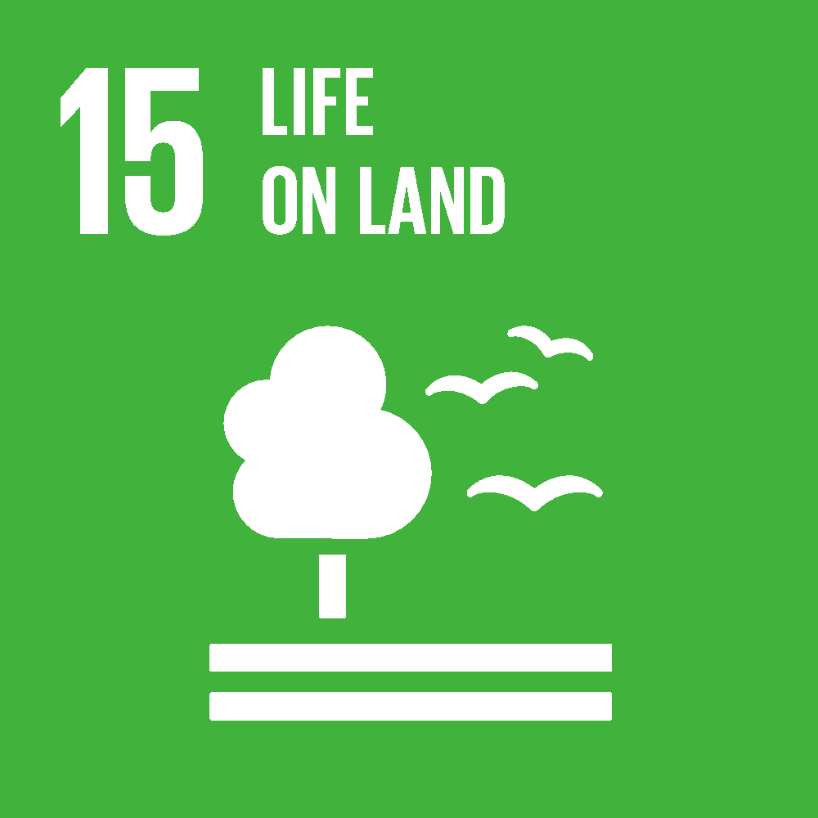
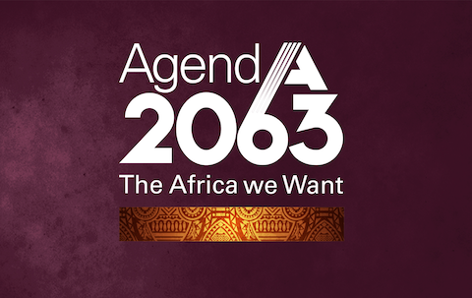
Data, decisions, development
POWERED BY:
Notes:
Digital Earth Africa works to improve the lives of people across the African continent by translating Earth observations into insights that will support sustainable water management, agricultural practice, food security and urbanisation.
The program makes Earth observation (EO) data readily available, delivering decision-ready products to the African continent.
With free and rapid access to the data they need, policy-makers, scientists, the private sector and civil society can innovate to address social, environmental and economic changes across the continent and respond effectively to the challenges of sustainable development.
Data generated by Digital Earth Africa will provide valuable insights for better decision making across many areas, including:
Land degradation
coastal erosion
urbanisation
water resources and flood risks
agriculture and food security
DE Africa is the world’s largest open data cube for accessing and analysing decades of satellite imagery of Africa’s lands and seas

Slide 6
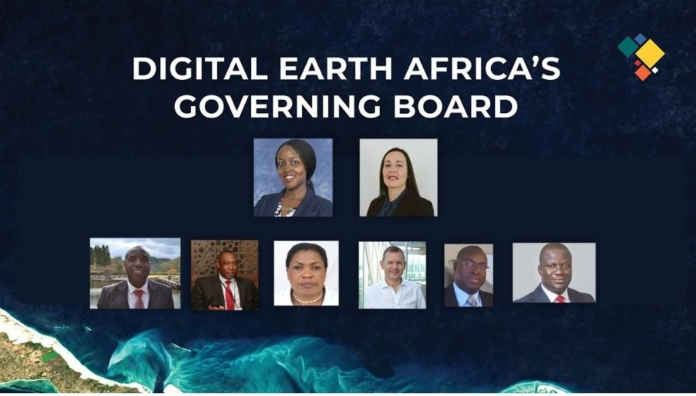
Supported by Strong Governance & Thriving Partnerships
Notes:
All supported by our governing groups and thriving partnerships….
Governance Framework is operational, effective and African owned
our governing board provides strategic oversight - 8 members
our technical advisory committee, ensures our program is responsive to African priorities and are very influential in program establishment and in-country engagement
DE Africa institutional, management and staffing capacity is established
Key outcome - Africa owned and run
SANSA - PMO host
5 implementing partner organisations supporting program delivery - these relations, established back in late 2020, are going from strength to strength - just finalising the 2022 work plan for each group
We have a extensive range of enabling partners and collaborators, for example
technical support, in-kind support from AWS and ESRI
aligned programs with whom we have common interests e.g. FAO, GEOGLAM, NASA_SERVIR etc

Slide 7
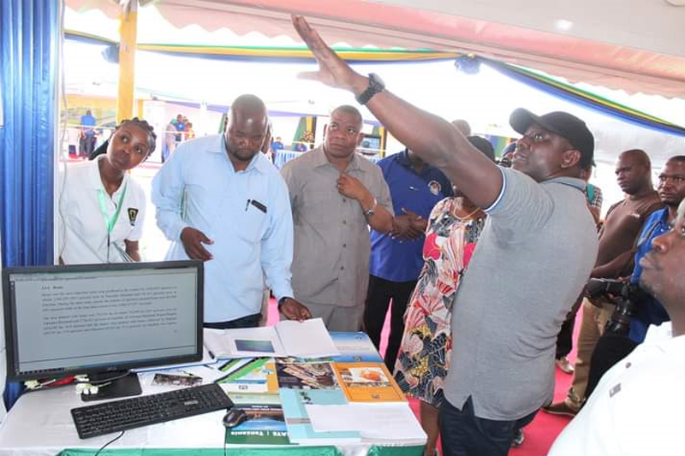
Institutional Strengthening
8
Continent Wide
Services
Government agencies and ministers are critical decision-makers, and direct engagement is vital to build relationships, capacity and awareness and to ensure that information from DE Africa is relevant and effective for governments.
We will work directly with Government Ministries - Statistics, Agriculture, Climate & etc. - to build in-country knowledge and skills, to tailor DE Africa information to specific national needs, and to ensure that the delivery of information from DE Africa is effective (e.g., information is delivered through the appropriate national institutions).
300+
Analytics packages released
25,000
active users by 2025
1,000
Trainers
trained by
2025
Tanzania Minister of Finance and Planning Dr Phillip S Mpango, NaneNane2020.
Every African country using DEA to answer climate and sustainability questions.
Notes:
Strengthening institutions for uptake of DE Africa, and ensuring that DE Africa provides the services that are needed at a country-level.

Slide 8
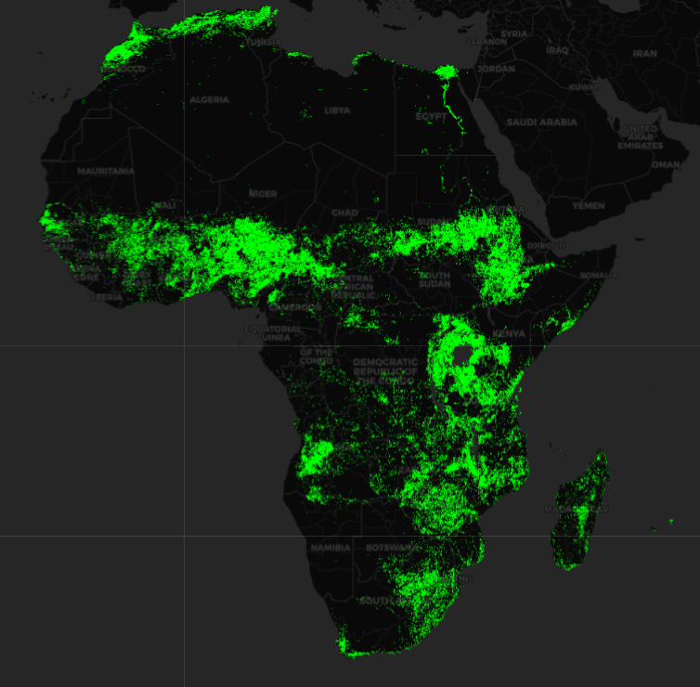
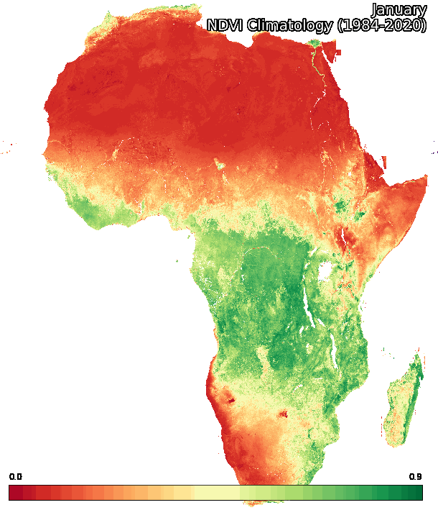
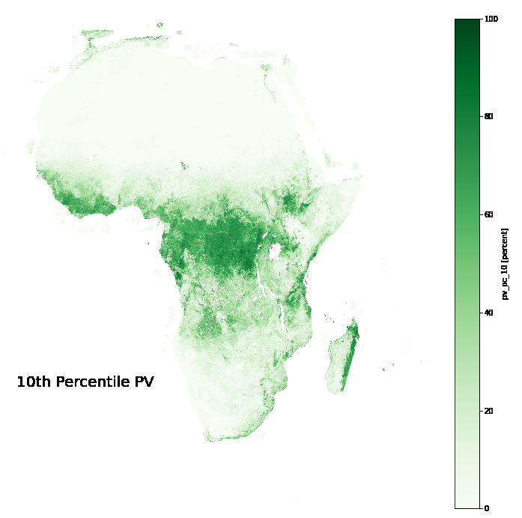
Food Security
8
Continent Wide
Services
DE Africa has developed services to provide information on vegetation condition, cropping and rainfall across Africa. This work is on-going, in collaboration with regional Implementing partner organisations.
The services will be further developed with the aim to empower governments, food producers, private companies with timely information to inform policy, production, financing and insurance.
300+
Analytics packages released
25,000
active users by 2025
Continental crop mask
Monthly NDVI Climatology
Fractional Cover Annual Summary (Percentiles)
1,000
Trainers
trained by
2025
Notes:
Finally, the big one, Food Security
Africa is home to 75 million people who are food-insecure or worse, and food security is a central focus for Governments across Africa.
DE Africa has developed services to provide information on vegetation condition, cropping and rainfall across Africa. This work is on-going, in collaboration with regional partner organisations based in Niger, Kenya, Nigeria, Sengal and Tunisia, with the FAO, with donors (BMGF) and the Australian Government
DE Africa services will be further developed with the aim to empower governments, food producers and financers with timely information to inform policy, production, financing and insurance.

Slide 9
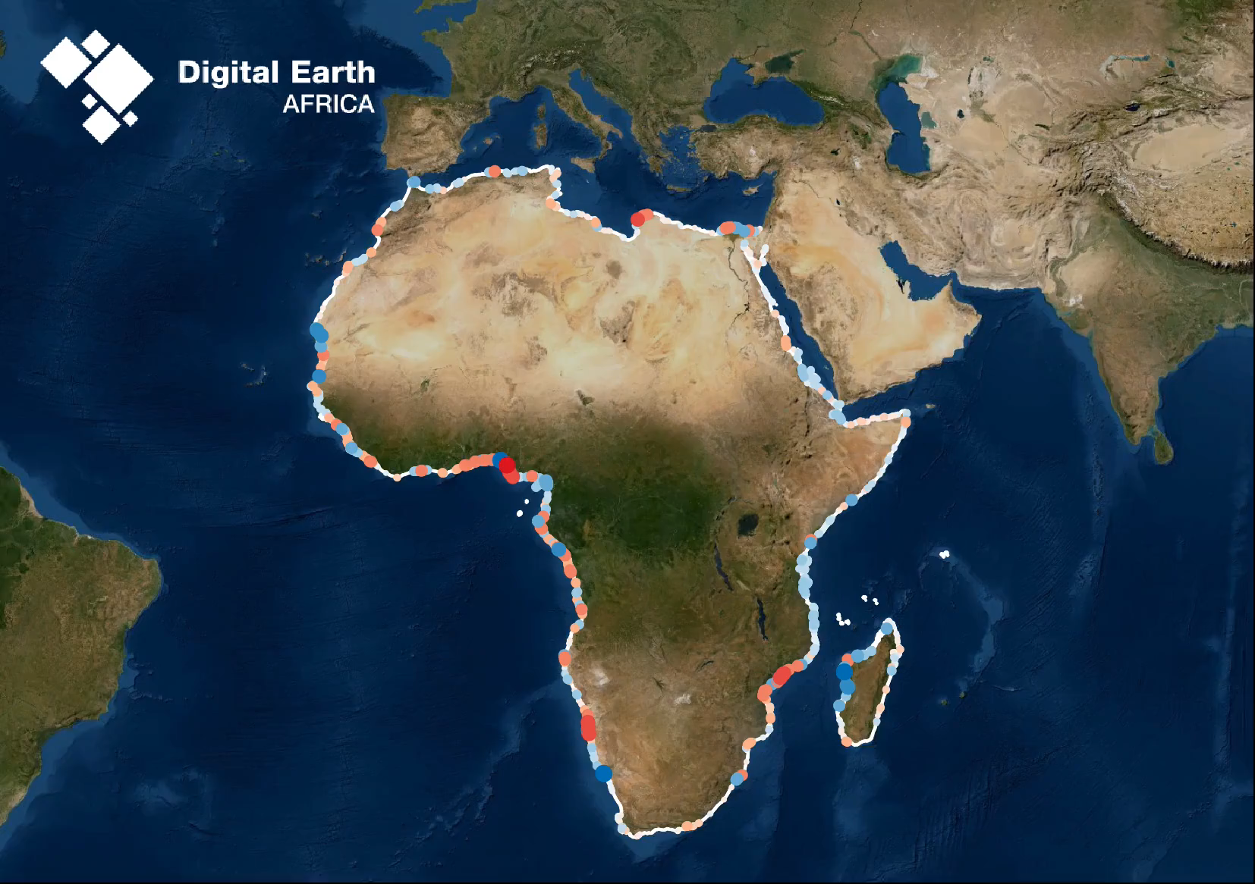
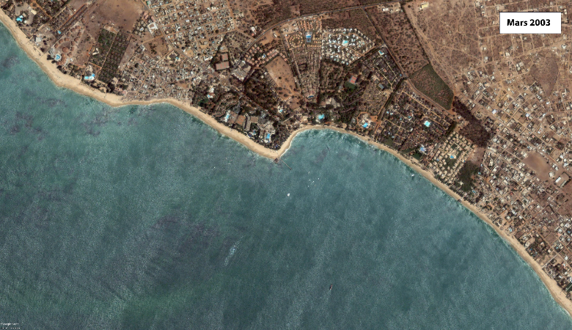
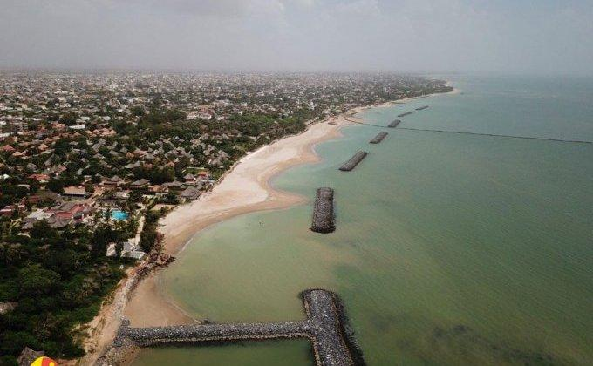
Coastal Monitoring Service
8
Continent Wide
Services
Coastal Monitoring Service is a continental dataset that includes annual shorelines and rates of coastal change along the entire African coastline from 2000 to 2021. The service enables trends of coastal erosion and growth to be examined annually at both a local and continental scale.
Developed and validated with our partners at CSE in Senegal
300+
Analytics packages released
25,000
active users by 2025
1,000
Trainers
trained by
2025
Notes:
Finally, the big one, Food Security
Africa is home to 75 million people who are food-insecure or worse, and food security is a central focus for Governments across Africa.
DE Africa has developed services to provide information on vegetation condition, cropping and rainfall across Africa. This work is on-going, in collaboration with regional partner organisations based in Niger, Kenya, Nigeria, Sengal and Tunisia, with the FAO, with donors (BMGF) and the Australian Government
DE Africa services will be further developed with the aim to empower governments, food producers and financers with timely information to inform policy, production, financing and insurance.

Slide 10
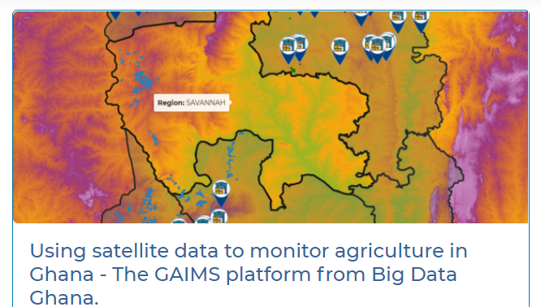
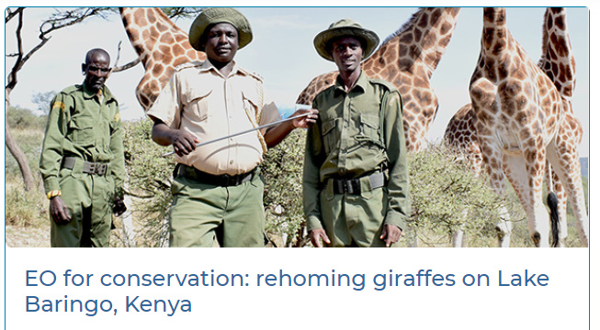
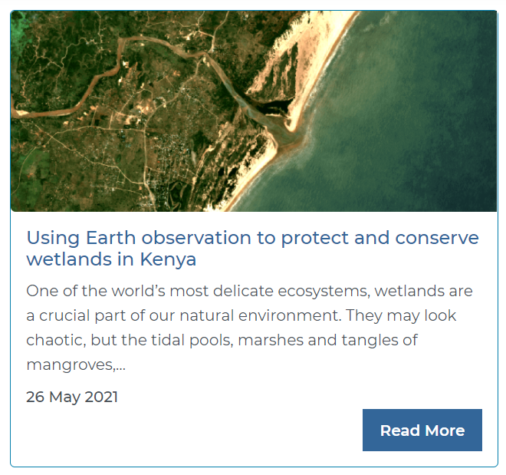
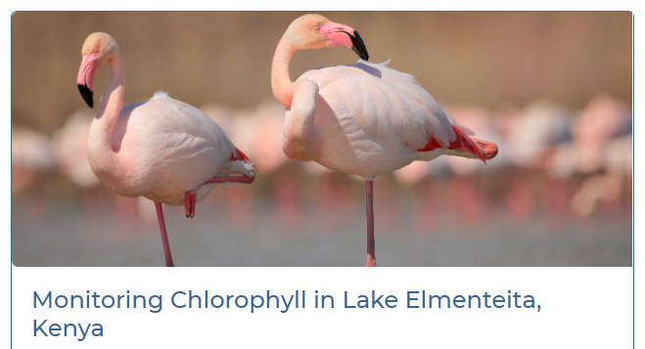
From Products to People
Making an impact
25 published use case studies (Kenya, Ghana, Tanzania, Botswana, Uganda), across government, industry, academic
7 use case studies in development (Senegal, Benin, Burkina Faso, Niger, Botswana, Kenya, Nigeria)
2 industry projects supported
‹#›

Slide 11
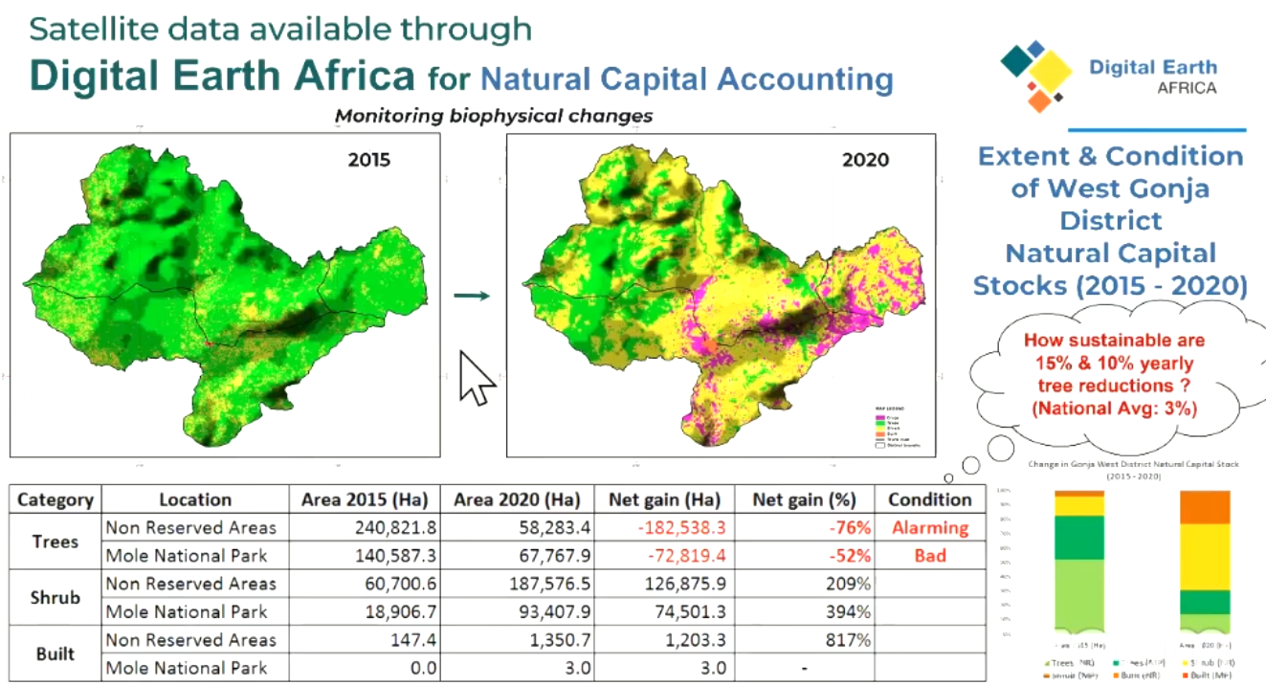
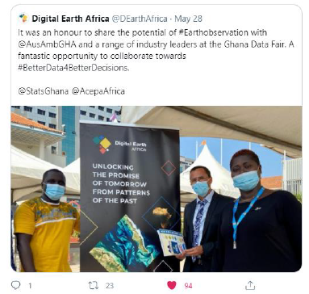
Supporting Government Decision Making - Ghana Statistical Service
Notes:
First Ghana stats service - showcases how DE Africa products / services are used to inform decision making.
Integrated DE Africa information into their constituency profiles -
Example of national capital accounting…

Slide 12
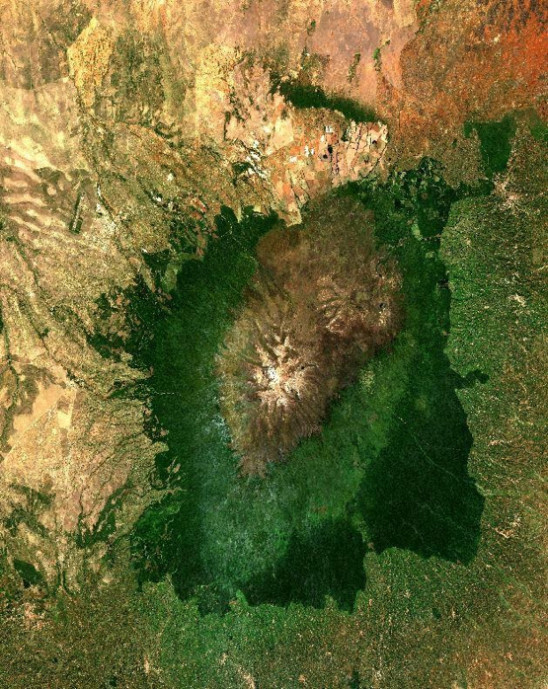
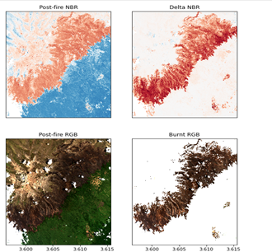
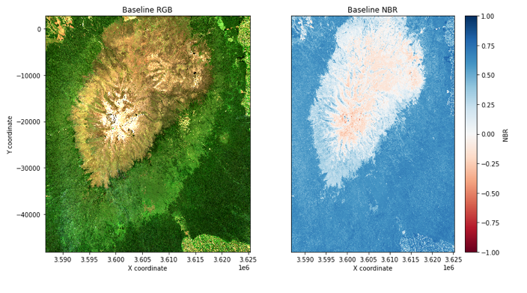
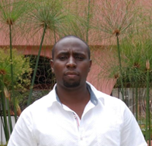
Use Case: Mapping forest fires
Rapid impact assessment - Mt Kenya
Notes:
Mount Kenya lies within the UNESCO designated World Heritage Site of Mount Kenya National Park and is a key driver of both local and international tourism to Kenya.
DE Africa is helping Eric Nganga from the Regional Centre for Mapping of Resources for Development (RCMRD) to provide a rapid assessment of the impact of fires in Mount Kenya. This will be useful in engagement with the Kenya Forest Service (KFS), which has been mandated with the task of monitoring forest cover.
Le mont Kenya se trouve dans le site du patrimoine mondial du parc national du mont Kenya, désigné par l'UNESCO et est un moteur clé du tourisme local et international au Kenya. DE Africa aide Eric Nganga du Centre régional de cartographie des ressources pour le développement (RCMRD) à fournir une évaluation rapide de l'impact des incendies sur le mont Kenya. Cela sera utile en collaboration avec le Kenya Forest Service (KFS), qui a été mandaté pour surveiller le couvert forestier.

Slide 13
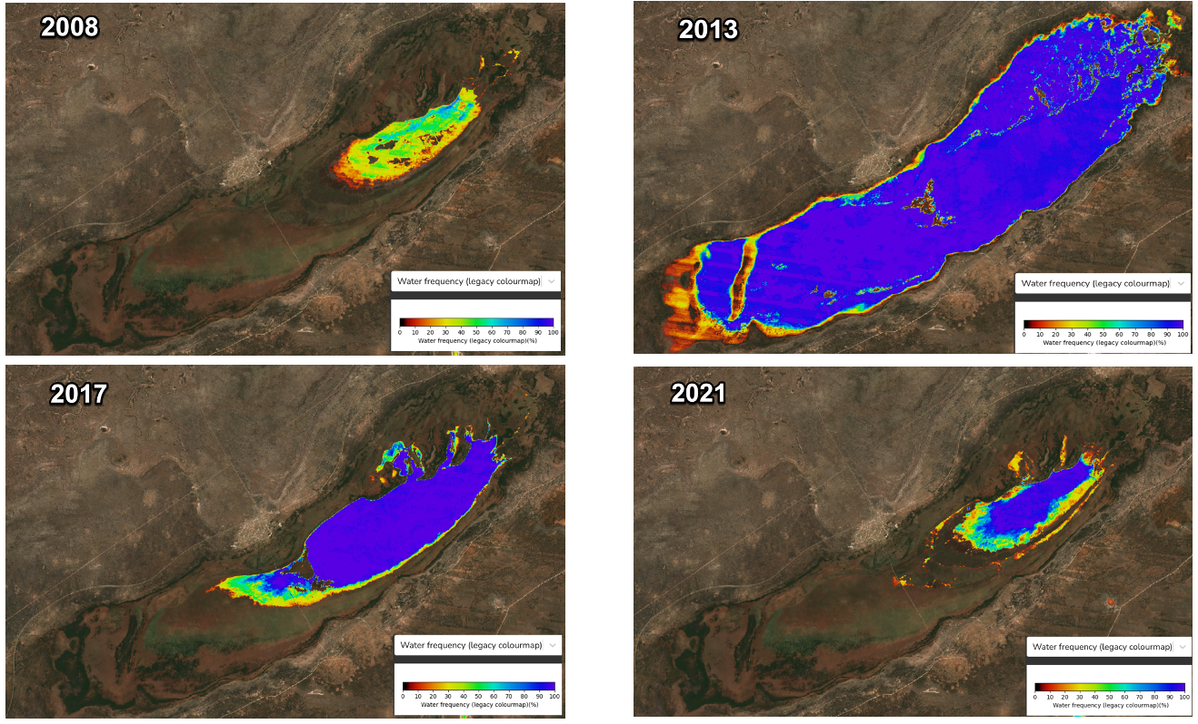
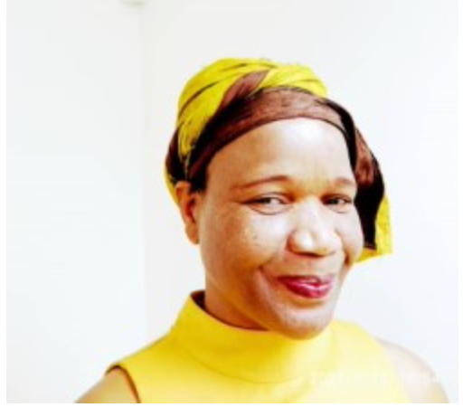
Use Case:
Water Assessment and Monitoring in the Lake Ngami, Lower Okavango Delta
Lake Ngami is located at the western part of the lower Okavango Delta and an indicator for environmental change and climate variability in the Okavango Basin.
Water Observation from Space (WOfS) are used to evaluate water variability in Lake Ngami, Botswana from the year 2017 to 2021.
The results for Lake Ngami indicate the need for an integrated watershed plan that encompasses the Okavango Delta.
Dr. Kelebogile B. Mfundisi is currently working as a Research Scholar in Physical Geography at the University of Botswana Maun Campus, Okavango Research Institute, Maun, Botswana. Dr. Kelebogile can be reached on email: kmfundisi@ub.ac.bw

Slide 14
Working Towards Sustainability
Beginning immediately and over 5 years, transition to a diverse funder base, including a blend of private and public sector funding to become the sustainably funded, continent-wide public good.
Digital Earth Africa
Steering committee
founded 2018
Platform
Launched
SANSA appointed to host the Program Management Office in 2021
We are
HERE
$25M in joint funding from
Hemsley Foundation & the Australian Government
in 2019
7500 user milestone
reached 2022
New African leadership
team 2022
African governed
Since 2020
3 PB of data
hosted on AWS
Phase-III Funding Goal 2022-2023
African funded 2025
Data hosted in Africa, 2020
Notes:
The new funding that we are looking for is to take DEA AFrica into a new phase, one of scaling for impact.
You have seen that the infrastructure is in place, and that it is valued and having impact, however to deliver value we need to escalate capacity building, engagement and further development of the technology platform.
The scaling phase of DEAfrica will target growth of users, engagement with countries, capacity building, and toolkits to focus DEAfrica on specific issues including Climate response and Agriculture.

Slide 15
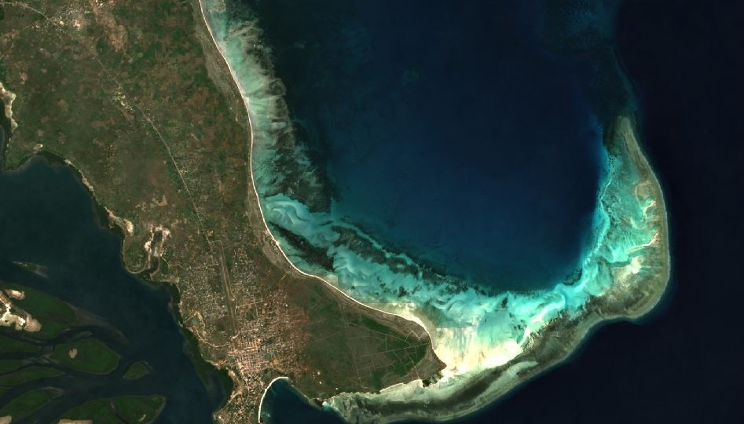
Looking Forward
Investment in the next phase of Digital Earth Africa will drive country-level capacity building to support climate action, agricultural forecasting, and institutional strengthening.
Eye of Sahara: Credit: Contains modified Copernicus Sentinel data 2021, processed by Digital Earth Africa.
Notes:
Program established back in 2019 0- funded by Helmsley and DFAT
- although the original IDD aimed for funds to be expended in 3 years - we are looking at a bit over 4 years. DFAT-GA ROU until end of June 2023
Vision -
Data generated by Digital Earth Africa is already providing valuable insights for better decision making across many areas, including:
Land degradation
coastal erosion
urbanisation
water resources and flood risks
agriculture and food security
All key issues amplified by climate change

Slide 16
How do you learn more about DE Africa?
Website https://www.digitalearthafrica.org
Map information: maps.digitalearth.africa
To request training and support contact us on: engage@digitalearthafrica.org
Online learning https://learn.digitalearthafrica.org
Notes:
Go to our website: https://www.digitalearthafrica.org/platform-resources/platform
Join our community: https://www.digitalearthafrica.org/subscribe
DE Africa weekly Live Sessions: every Wednesday at 11am, GMT zero) - ask questions and connect: https://us04web.zoom.us/j/5890793425
Email us at: info@digitalearthafrica.org

Slide 17
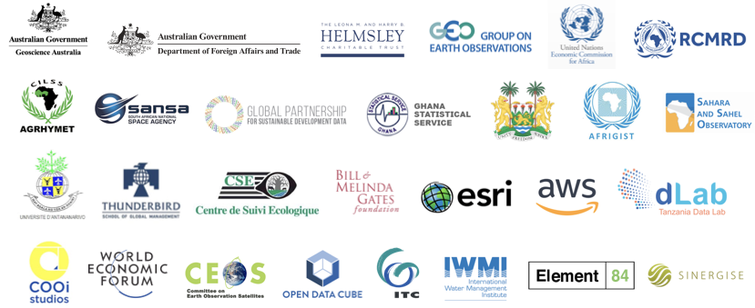
Acknowledgements
Notes:
Acknowledgements

Slide 18
Thank you Merci obrigada
Zviko Mudimu
Head of Operations
Digital Earth Africa
zviko.mudimu@digitalearthafrica.org
Jërëjëf. Kea leboga. meda wo ase
Amesegnalaw. Weebale.
Asante. E ṣeun. Murakoze.

